Slide 1
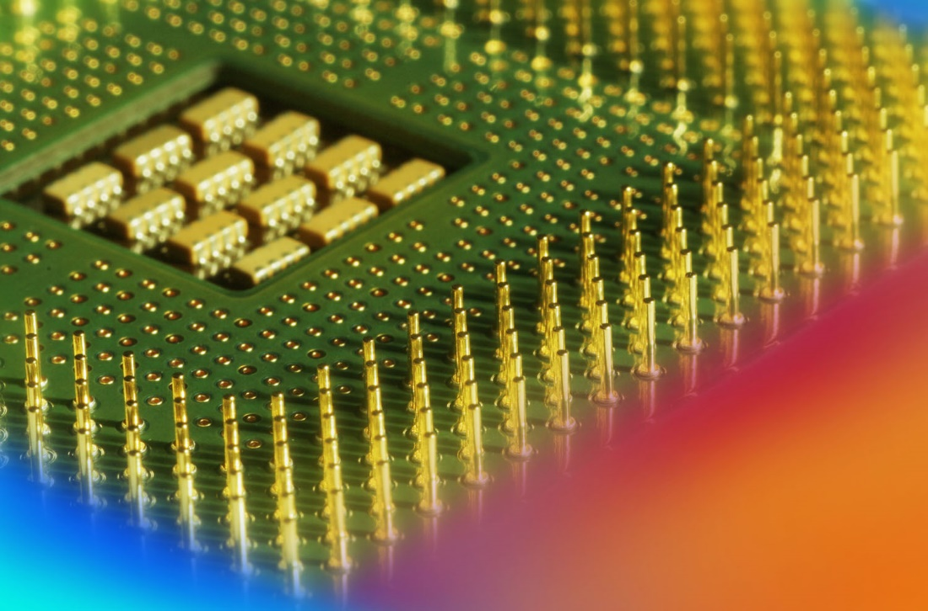
Digital Fundamentals
Tenth Edition
Floyd
Chapter 6
© 2008 Pearson Education

Slide 2
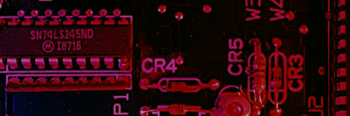
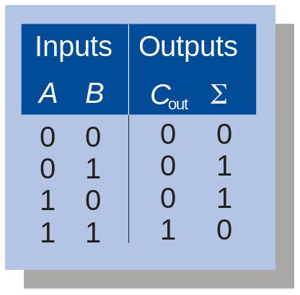
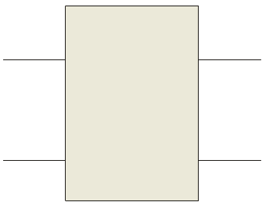
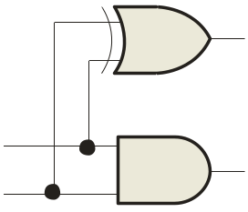
Summary
Half-Adder
Basic rules of binary addition are performed by a half adder, which has two binary inputs (A and B) and two binary outputs (Carry out and Sum).
The inputs and outputs can be summarized on a truth table.
The logic symbol and equivalent circuit are:
Σ
Σ
A
Σ
A
C_{out}
B
C_{out}
B

Slide 3
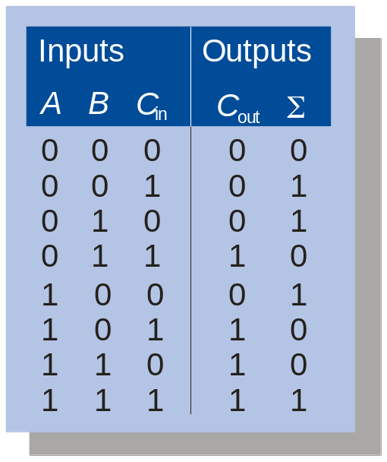
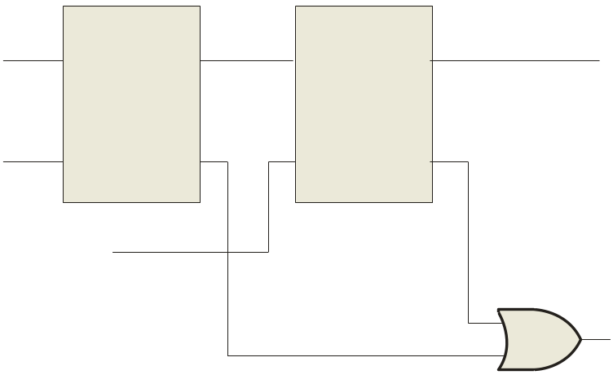
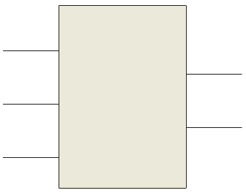
Summary
Full-Adder
By contrast, a full adder has three binary inputs (A, B, and Carry in) and two binary outputs (Carry out and Sum). The truth table summarizes the operation.
A full-adder can be constructed from two half adders as shown:
Σ
Σ
Σ
Σ
A
A
A
Sum
Σ
B
B
C_{out}
B
C_{out}
A
Σ
B
C_{out}
C_{in}
C_{in}
C_{out}
Symbol

Slide 4

Summary
Full-Adder
Σ
Σ
1
Σ
Σ
0
Sum
1
A
A
Example
B
0
1
0
C_{out}
B
C_{out}
For the given inputs, determine the intermediate and final outputs of the full adder.
1
C_{out}
1
Solution
The first half-adder has inputs of 1 and 0; therefore the Sum =1 and the Carry out = 0.
The second half-adder has inputs of 1 and 1; therefore the Sum = 0 and the Carry out = 1.
The OR gate has inputs of 1 and 0, therefore the final carry out = 1.

Slide 5
Summary
Full-Adder
Notice that the result from the previous example can be read directly on the truth table for a full adder.
Σ
Σ
1
Σ
Σ
0
Sum
1
A
A
B
0
1
0
C_{out}
B
C_{out}
1
C_{out}
1

Slide 6
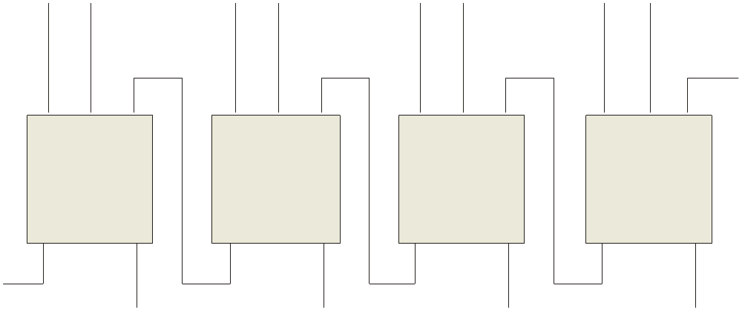
Summary
Parallel Adders
Full adders are combined into parallel adders that can add binary numbers with multiple bits. A 4-bit adder is shown.
A₄ B₄
A₃ B₃
A₂ B₂
A₁ B₁
C₀
A
B
C_{in}
A
B
C_{in}
A
B
C_{in}
A
B
C_{in}
C_{out}
Σ
C_{out}
Σ
C_{out}
Σ
C_{out}
Σ
C₄
C₃
C₂
C₁
Σ₄
Σ₃
Σ₂
Σ₁
The output carry (C₄) is not ready until it propagates through all of the full adders. This is called ripple carry, delaying the addition process.

Slide 7
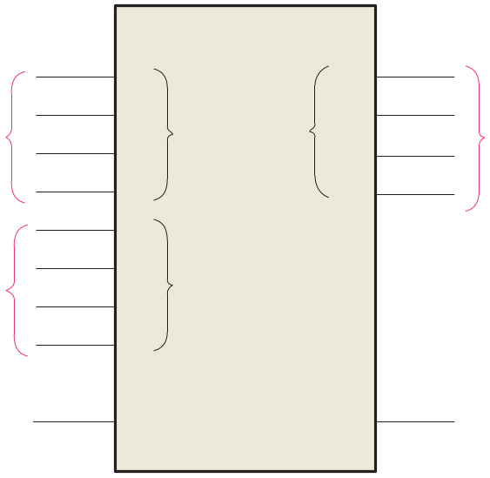
Summary
Parallel Adders
The logic symbol for a 4-bit parallel adder is shown. This 4-bit adder includes a carry in (labeled (C₀) and a Carry out (labeled C₄).
Σ
1
2
3
4
1
2
3
4
Binary number A
4-bit sum
1
2
3
4
Binary number B
Input carry
C₀
C₄
Output carry
The 74LS283 is an example. It features look-ahead carry, which adds logic to minimize the output carry delay. For the 74LS283, the maximum delay to the output carry is 17 ns.

Slide 8
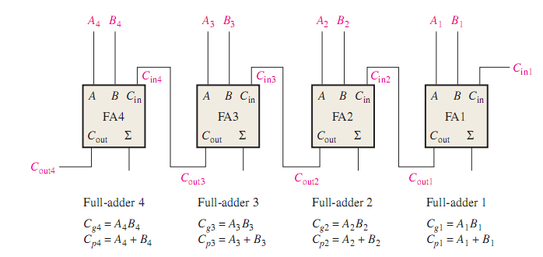

Slide 9
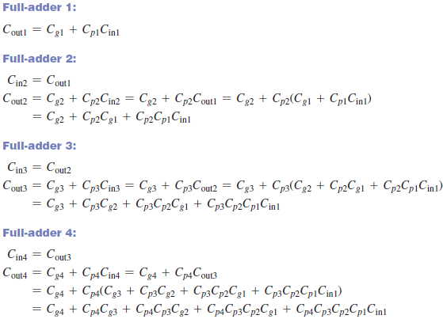

Slide 10
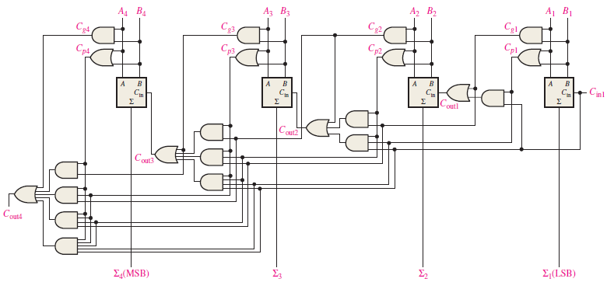

Slide 11
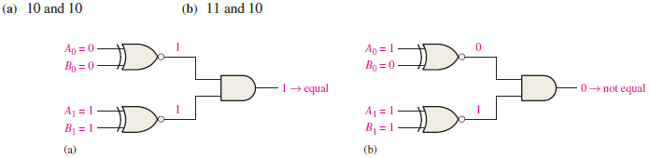
Comparators

Slide 12
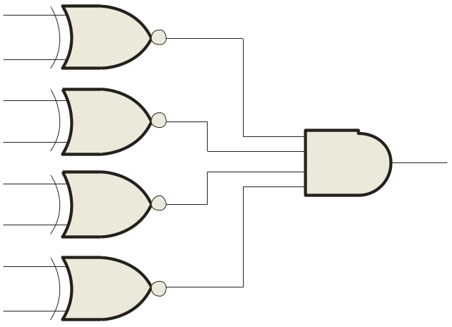
Summary
Comparators
The function of a comparator is to compare the magnitudes of two binary numbers to determine the relationship between them. In the simplest form, a comparator can test for equality using XNOR gates.
Example
How could you test two 4-bit numbers for equality?
Solution
AND the outputs of four XNOR gates.
A₁
B₁
A₂
B₂
Output
A₃
B₃
A₄
B₄

Slide 13
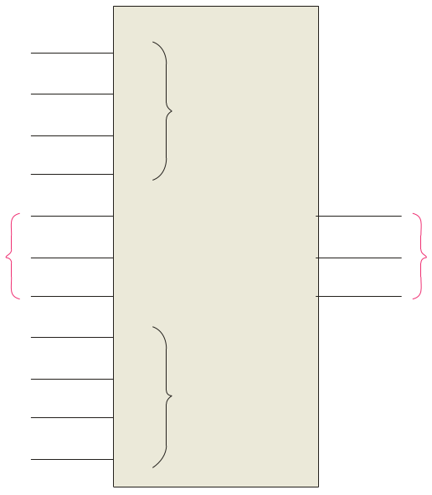
Summary
Comparators
IC comparators provide outputs to indicate which of the numbers is larger or if they are equal. The bits are numbered starting at 0, rather than 1 as in the case of adders. Cascading inputs are provided to expand the comparator to larger numbers.
COMP
A₀
0
A₁
A
A₂
A₃
3
Cascading inputs
A > B
A > B
A = B
A = B
Outputs
A < B
A < B
B₀
0
B₁
A
The IC shown is the 4-bit 74LS85.
B₂
B₃
3

Slide 14
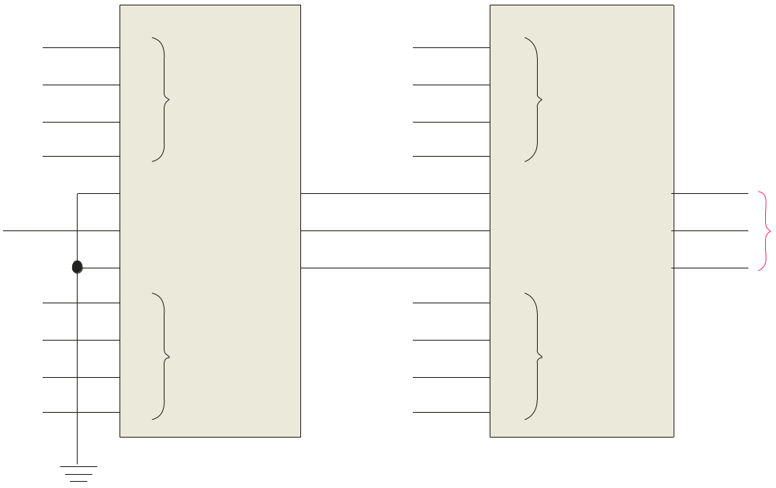
Summary
Comparators
IC comparators can be expanded using the cascading inputs as shown. The lowest order comparator has a HIGH on the A = B input.
LSBs
MSBs
A₀
COMP
A₄
COMP
A₁
0
A₅
0
A₂
A
A₆
A
A₃
A₇
3
3
A > B
A > B
A > B
A > B
+5.0 V
A = B
A = B
A = B
A = B
Outputs
B₀
A < B
A < B
B₄
A < B
A < B
0
0
B₁
A
B₅
A
B₂
B₆
B₃
3
B₇
3

Slide 15
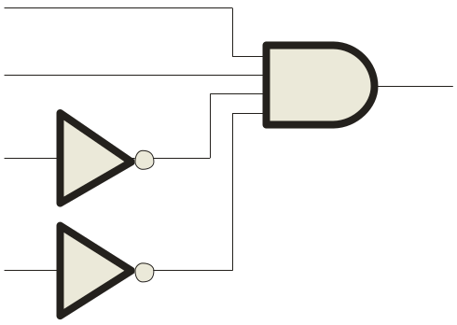

Summary
Decoders
A decoder is a logic circuit that detects the presence of a specific combination of bits at its input. Two simple decoders that detect the presence of the binary code 0011 are shown. The first has an active HIGH output; the second has an active LOW output.
A₀
A₀
A₁
X
A₁
X
A₂
A₂
A₃
A₃
Active HIGH decoder for 0011
Active LOW decoder for 0011

Slide 16
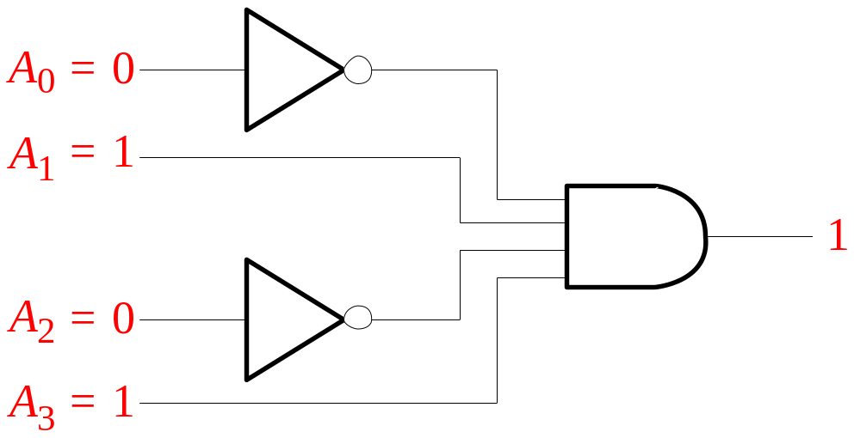

Summary
Decoders
Question
Assume the output of the decoder shown is a logic 1. What are the inputs to the decoder?

Slide 17
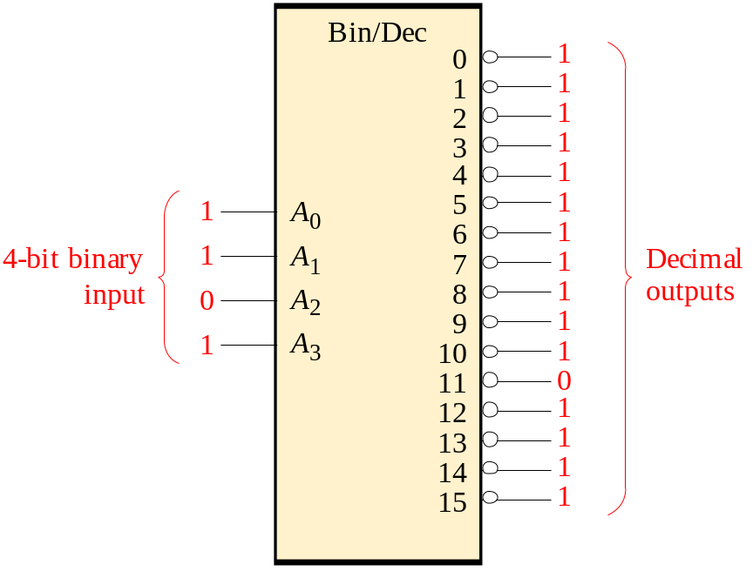
Summary
Decoders
IC decoders have multiple outputs to decode any combination of inputs. For example the binary-to-decimal decoder shown here has 16 outputs – one for each combination of binary inputs.
Question
For the input shown, what is the output?

Slide 18
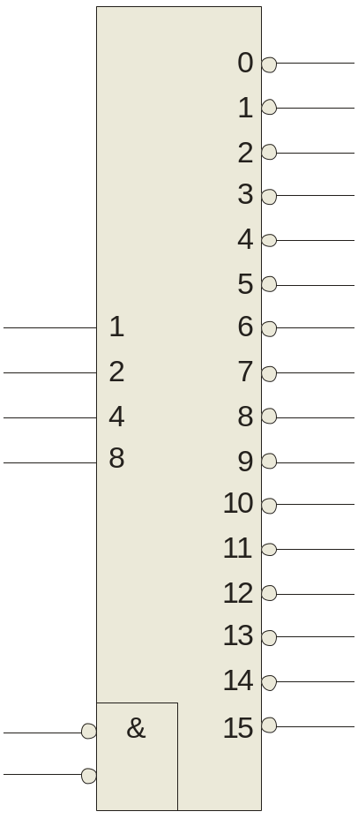
Summary
Decoders
X/Y
A specific integrated circuit decoder is the 74HC154 (shown as a 4-to-16 decoder). It includes two active LOW chip select lines which must be at the active level to enable the outputs. These lines can be used to expand the decoder to larger inputs.
A₀
A₁
A₂
A₃
CS₁
CS₂
EN
74HC154

Slide 19
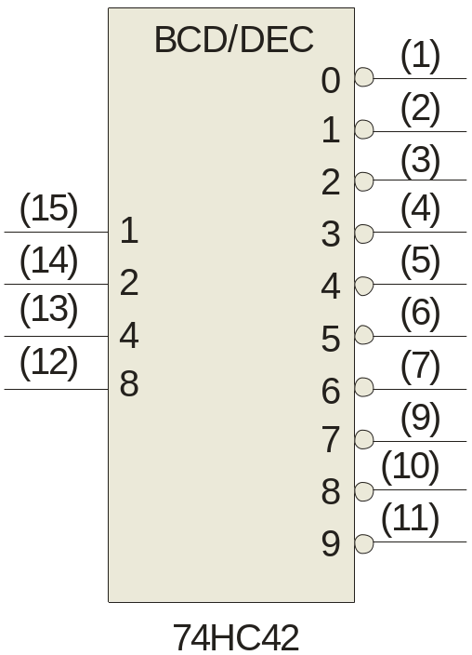
Summary
Decoders
BCD-to-decimal decoders accept a binary coded decimal input and activate one of ten possible decimal digit indications.
A₀
A₁
A₂
A₃
Example
Assume the inputs to the 74HC42 decoder are the sequence 0101, 0110, 0011, and 0010. Describe the output.
Solution
All lines are HIGH except for one active output, which is LOW. The active outputs are 5, 6, 3, and 2 in that order.

Slide 20
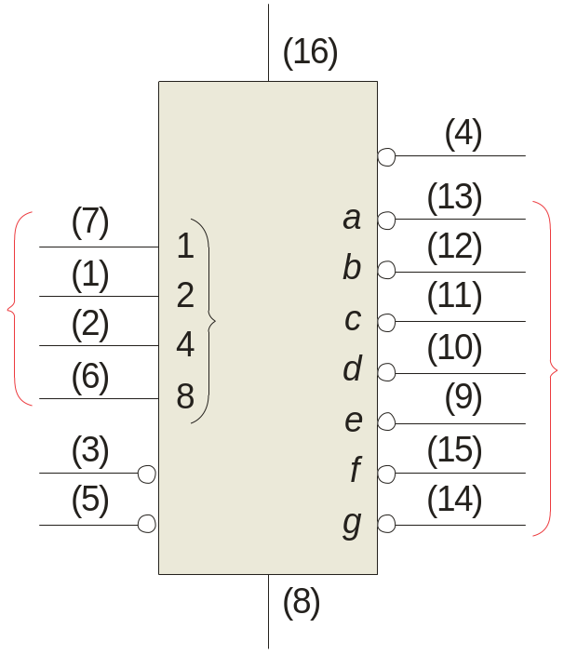
Summary
BCD Decoder/Driver
Another useful decoder is the 74LS47. This is a BCD-to-seven segment display with active LOW outputs.
V_{CC}
The a-g outputs are designed for much higher current than most devices (hence the word driver in the name).
BCD/7-seg
BI/RBO
BI/RBO
BCD inputs
Outputs to seven segment device
LT
LT
RBI
RBI
74LS47
GND

Slide 21
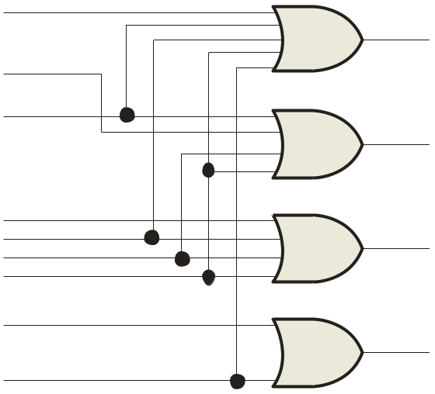
Summary
Encoders
An encoder accepts an active logic level on one of its inputs and converts it to a coded output, such as BCD or binary.
The decimal to BCD is an encoder with an input for each of the ten decimal digits and four outputs that represent the BCD code for the active digit. The basic logic diagram is shown. There is no zero input because the outputs are all LOW when the input is zero.
1
A₀
2
3
A₁
4
5
A₂
6
7
8
A₃
9

Slide 22
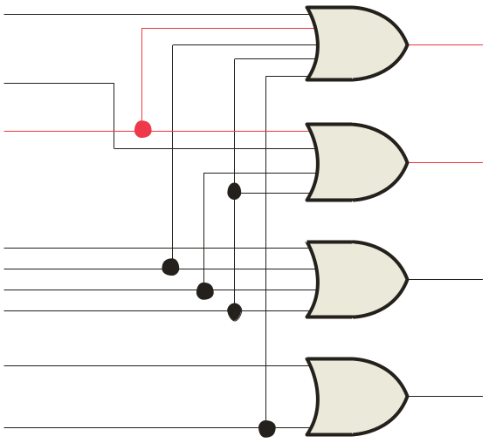
Summary
Encoders
Example
Show how the decimal-to-BCD encoder converts the decimal number 3 into a BCD 0011.
Solution
The top two OR gates have ones as indicated with the red lines. Thus the output is 0111.
1
0
1
A₀
2
0
1
3
1
A₁
4
0
5
0
0
A₂
6
0
0
7
8
0
0
0
A₃
9

Slide 23
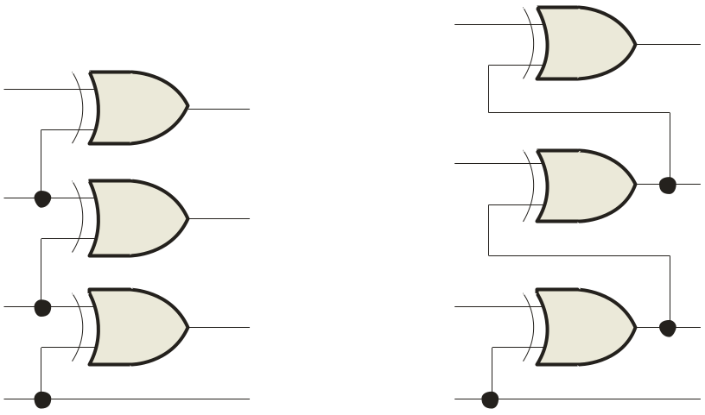
Summary
Code converters
There are various code converters that change one code to another. Two examples are the four bit binary-to-Gray converter and the Gray-to-binary converter.
Example
Show the conversion of binary 0111 to Gray and back.
0
1
LSB
Solution
1
0
LSB
0
1
1
0
1
1
1
1
0
0
0
MSB
0
MSB
Binary-to-Gray Gray-to-Binary

Slide 24
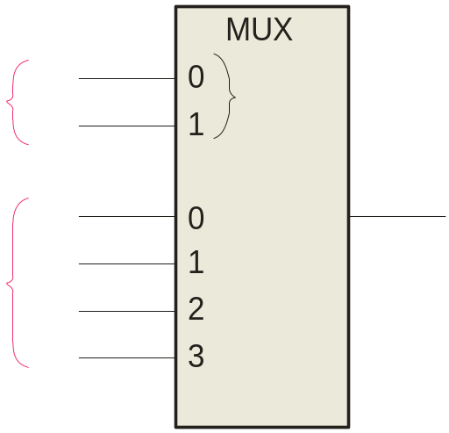
Summary
Multiplexers
A multiplexer (MUX) selects one data line from two or more input lines and routes data from the selected line to the output. The particular data line that is selected is determined by the select inputs.
Two select lines are shown here to choose any of the four data inputs.
S₀
0
Data
select
1
S₁
D₀
Data
output
Question
Data
inputs
D₁
D₂
Which data line is selected if S₁S₀ = 10?
D₃
D₂

Slide 25
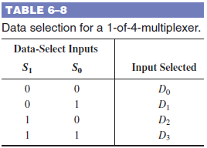


Slide 26
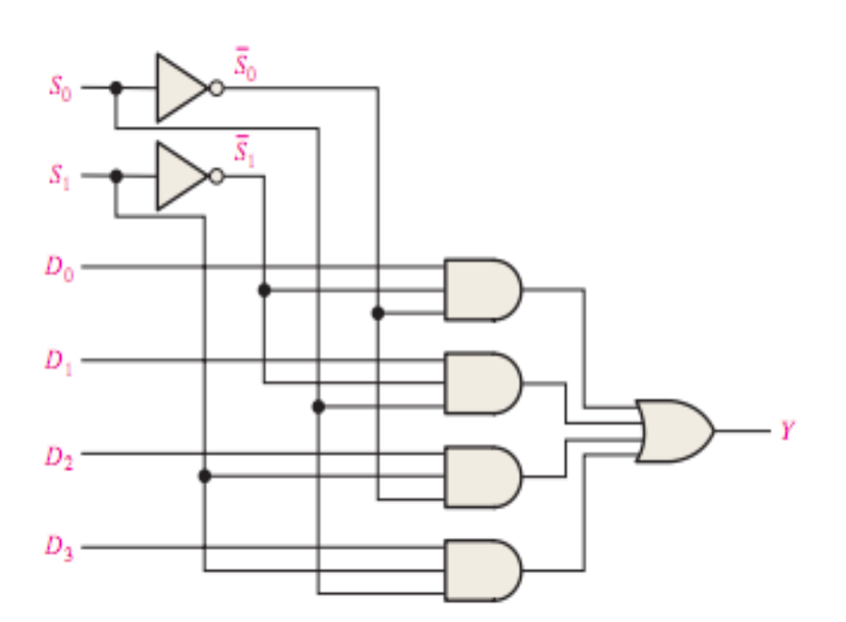

Slide 27
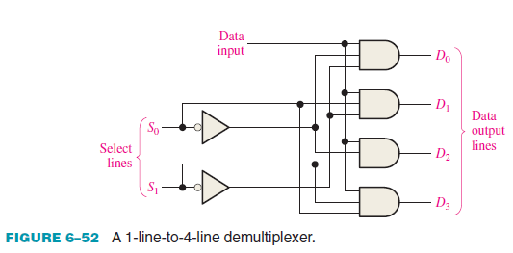

Slide 28
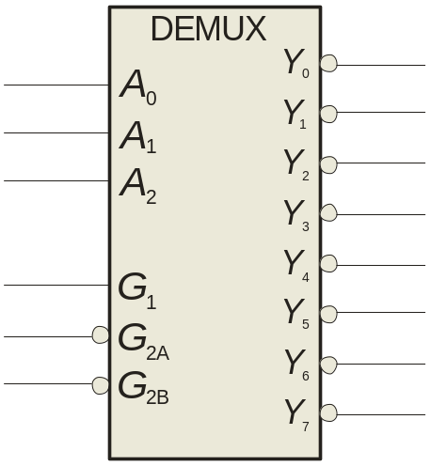
Summary
Demultiplexers
A demultiplexer (DEMUX) performs the opposite function from a MUX. It switches data from one input line to two or more data lines depending on the select inputs.
The 74LS138 was introduced previously as a decoder but can also serve as a DEMUX. When connected as a DEMUX, data is applied to one of the enable inputs, and routed to the selected output line depending on the select variables. Note that the outputs are active-LOW as illustrated in the following example…
Data select lines
Data outputs
Enable
inputs
74LS138

Slide 29
Summary
A
0
A
Demultiplexers
1
A
Example
Determine the outputs, given the inputs shown.
2
G
1
Solution
G
LOW
2A
The output logic is opposite to the input because of the active-LOW convention. (Red shows the selected line).
G
LOW
2B
Y
0
Y
1
Data select lines
Y
2
Y
Data outputs
3
Y
Enable
inputs
4
Y
5
Y
6
Y
74LS138
7

Slide 30

Summary
Parity Generators/Checkers
Parity is an error detection method that uses an extra bit appended to a group of bits to force them to be either odd or even. In even parity, the total number of ones is even; in odd parity the total number of ones is odd.
Example
The ASCII letter S is 1010011. Show the parity bit for the letter S with odd and even parity.
Solution
S with odd parity =
11010011
S with even parity =
01010011

Slide 31
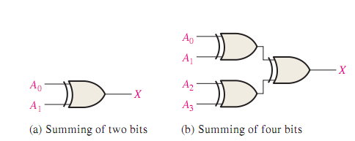

Slide 32
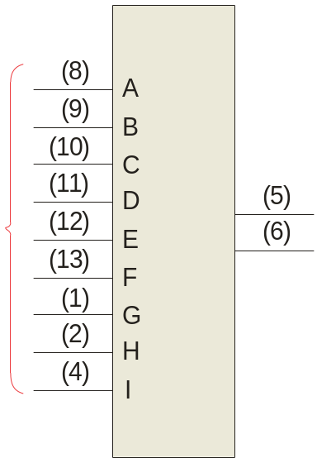
Summary
Parity Generators/Checkers
The 74LS280 can be used to generate a parity bit or to check an incoming data stream for even or odd parity.
Checker: The 74LS280 can test codes with up to 9 bits. The even output will normally be HIGH if the data lines have even parity; otherwise it will be LOW. Likewise, the odd output will normally be HIGH if the data lines have odd parity; otherwise it will be LOW.
Data inputs
Σ Even
Σ Odd
Generator: To generate even parity, the parity bit is taken from the odd parity output. To generate odd parity, the output is taken from the even parity output.
74LS280

Slide 33
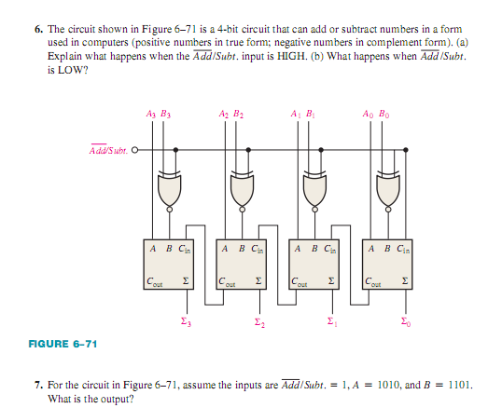

Slide 34
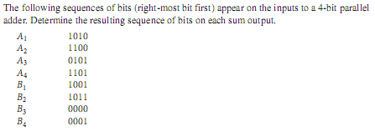

Slide 35
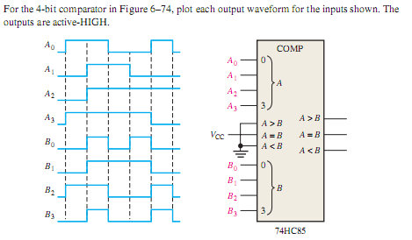

Slide 36
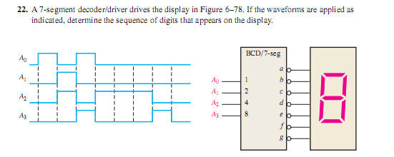

Slide 37
Design a 4-bit Gray code to Binary converter.

Slide 38
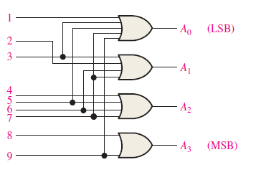
For the decimal-to-BCD encoder logic of Fig-5, assume that the input level 9 and 2 are both HIGH. What is the output code? Is it a valid BCD (8421) code

Slide 39
Implement the following Boolean function using a decoder.
F(A, B, C,D) = Σ ( 1, 2, 3,7,9,13,15)

Slide 40
Construct a 16 X 1 multiplexer with two 8x1 and one 4x1 multiplexers. Use block diagrams only.

Slide 41
Selected Key Terms
Full-adder
Cascading
Ripple carry
Look-ahead carry
A digital circuit that adds two bits and an input carry bit to produce a sum and an output carry.
Connecting two or more similar devices in a manner that expands the capability of one device.
A method of binary addition in which the output carry from each adder becomes the input carry of the next higher order adder.
A method of binary addition whereby carries from the preceding adder stages are anticipated, thus eliminating carry propagation delays.

Slide 42
Selected Key Terms
Decoder
Encoder
Priority encoder
Multiplexer (MUX)
Demultiplexer (DEMUX)
A digital circuit that converts coded information into a familiar or noncoded form.
A digital circuit that converts information into a coded form.
An encoder in which only the highest value input digit is encoded and any other active input is ignored.
A circuit that switches digital data from several input lines onto a single output line in a specified time sequence.
A circuit that switches digital data from one input line onto a several output lines in a specified time sequence.

Slide 43

Quiz
1. For the full-adder shown, assume the input bits are as shown with A = 0, B = 0, C_{in} = 1. The Sum and C_{out} will be
a. Sum = 0 C_{out} = 0
b. Sum = 0 C_{out} = 1
c. Sum = 1 C_{out} = 0
d. Sum = 1 C_{out} = 1
Σ
Σ
Σ
Σ
Sum
0
A
A
0
B
C_{out}
B
C_{out}
1
C_{out}
© 2008 Pearson Education

Slide 44
Quiz
2. The output will be LOW if
a. A < B
b. A > B
c. both a and b are
correct
d. A = B
A₁
B₁
A₂
B₂
Output
A₃
B₃
A₄
B₄
© 2008 Pearson Education

Slide 45
Quiz
3. If you expand two 4-bit comparators to accept two 8-bit numbers, the output of the least significant comparator is
a. equal to the final output
b. connected to the cascading inputs of the most
significant comparator
c. connected to the output of the most significant
comparator
d. not used
© 2008 Pearson Education

Slide 46
Quiz
4. Assume you want to decode the binary number 0011 with an active-LOW decoder. The missing gate should be
a. an AND gate
b. an OR gate
c. a NAND gate
d. a NOR gate
A₀
A₁
?
X
A₂
A₃
© 2008 Pearson Education

Slide 47
Quiz
5. Assume you want to decode the binary number 0011 with an active-HIGH decoder. The missing gate should be
a. an AND gate
b. an OR gate
c. a NAND gate
d. a NOR gate
A₀
A₁
?
X
A₂
A₃
© 2008 Pearson Education

Slide 48
Quiz
6. The 74138 is a 3-to-8 decoder. Together, two of these ICs can be used to form one 4-to-16 decoder. To do this, connect
a. one decoder to the LSBs of the input; the other decoder to the MSBs of the input
b. all chip select lines to ground
c. all chip select lines to their active levels
d. one chip select line on each decoder to the input MSB
© 2008 Pearson Education

Slide 49
Quiz
7. The decimal-to-binary encoder shown does not have a zero input. This is because
a. when zero is the input,
all lines should be LOW
b. zero is not important
c. zero will produce
illegal logic levels
d. another encoder is used
for zero
1
A₀
2
3
A₁
4
5
A₂
6
7
8
A₃
9
© 2008 Pearson Education

Slide 50
Quiz
8. If the data select lines of the MUX are S₁S₀ = 11, the output will be
a. LOW
b. HIGH
c. equal to D₀
d. equal to D₃
Data
select
S₀
S₁
D₀
Data
output
Data
inputs
D₁
D₂
D₃
© 2008 Pearson Education

Slide 51
Quiz
9. The 74138 decoder can also be used as
a. an encoder
b. a DEMUX
c. a MUX
d. none of the above
© 2008 Pearson Education

Slide 52
Quiz
10. The 74LS280 can generate even or odd parity. It can also be used as
a. an adder
b. a parity tester
c. a MUX
d. an encoder
© 2008 Pearson Education

Slide 53
Quiz
Answers:
1. c
2. c
3. b
4. c
5. a
6. d
7. a
8. d
9. b
10. b

